Slide 1


Customer
Segmentation
Data Science Lab Project- Jan 2021
Corrado Montoro - 841489
Ennio Guzmán - 848334
Notes:
Corrado

Slide 2
Division of work
We’ve actually worked together, but we decided to reply to eventual questions this way:
Corrado:
Correlation
Standardized PCA
Silhouette
Analysis and interpretation
Ennio:
Elbow:
K-means
Hierarchical
Davies-Bouldin

Slide 3

Context
We are a data analytics company, specialized in AI techniques and Investments Strategies.
An investment bank asked us to give us their dataset to find new insights.
The dataset contains data on 5000 customers, with features on their characteristics and on the financial products they bought.
The main goal of the analysis is to get insights of by descriptive statistics and clustering. We want to find out what type of customer prefers what type of financial product.
This way, financial advisors can give more specific advice based on the category a customer belongs to.
Notes:
Corrado

Slide 4

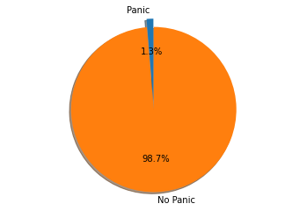
Explorative analysis
We divided the dataset in 2 main areas of interest:
Financial investment
Customer Profiles
Near zero variance in the variable Panic Mood

Slide 5
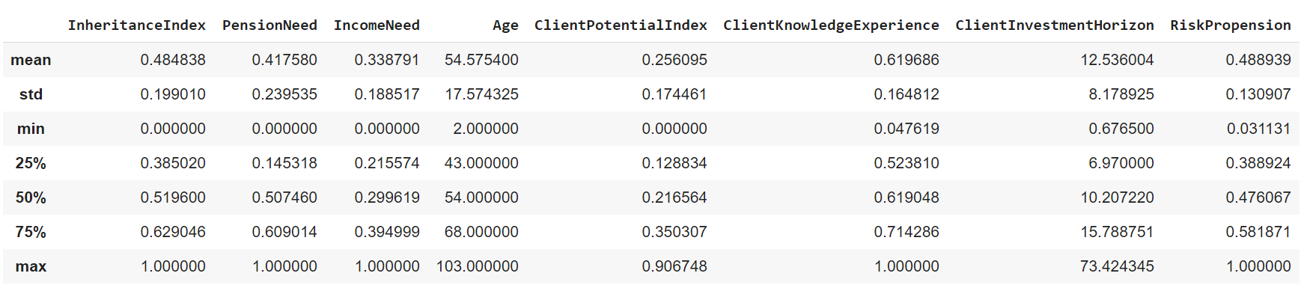
Customer profile - descriptive summary

Slide 6
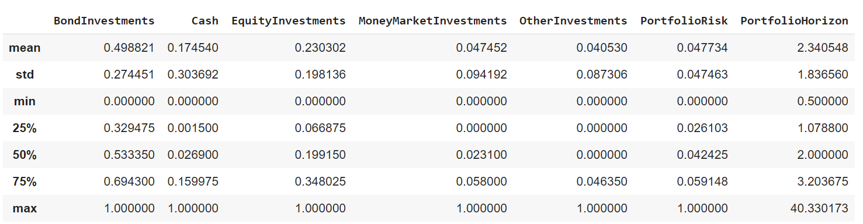
Financial Products - Descriptive statistics

Slide 7

Method
Algorithms:
K-means
Hierarchical clustering: Agglomerative
To find number of clusters:
Dendogram (Hierarchical clustering)
Elbow method (K-means)
Silhouette (K-means)
To evaluate clustered data:
Davies-Bouldin Score: an internal evaluation scheme, where the validation of how well the clustering has been done is made using quantities and features inherent to the dataset.
Notes:
Corrado

Slide 8
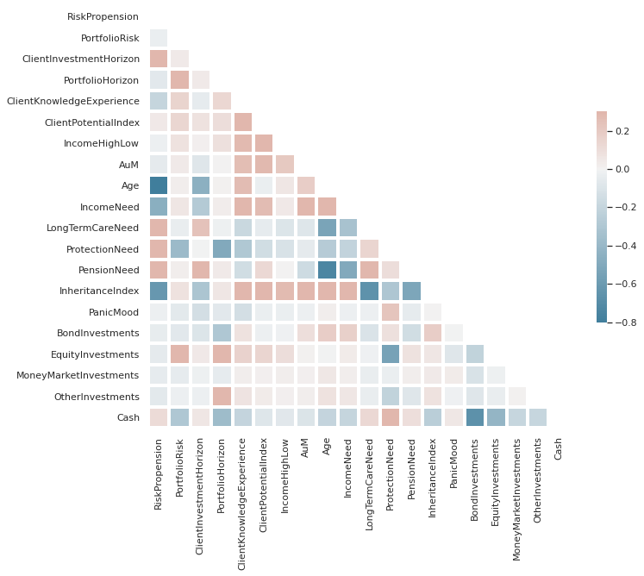
Correlation of the investment variables and profile variables
Notes:
Corrado

Slide 9
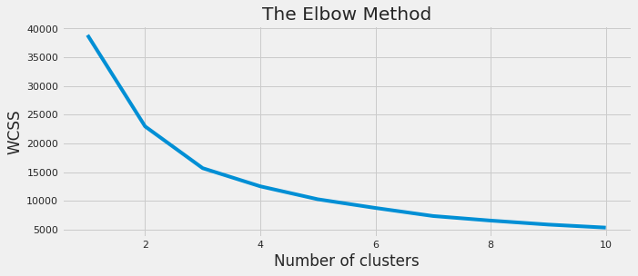
The elbow method and the Silhouette method
for n_clusters = 2 The average silhouette_score is: 0.36884370472365197
for n_clusters = 3 The average silhouette_score is: 0.37308067646249854
for n_clusters = 4 The average silhouette_score is: 0.3444119087444842
for n_clusters = 5 The average silhouette_score is: 0.35064972306221714
for n_clusters = 6 The average silhouette_score is: 0.342241310118284
for n_clusters = 7 The average silhouette_score is: 0.3530052894315681
for n_clusters = 8 The average silhouette_score is: 0.3481864900057546
for n_clusters = 9 The average silhouette_score is: 0.3487786628666999
Notes:
Corrado

Slide 10
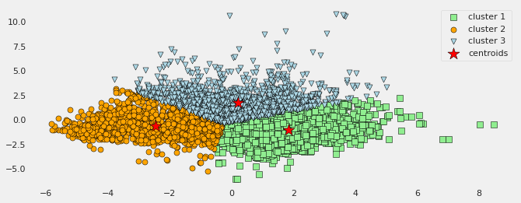
K-mean clustering
Notes:
Ennio

Slide 11
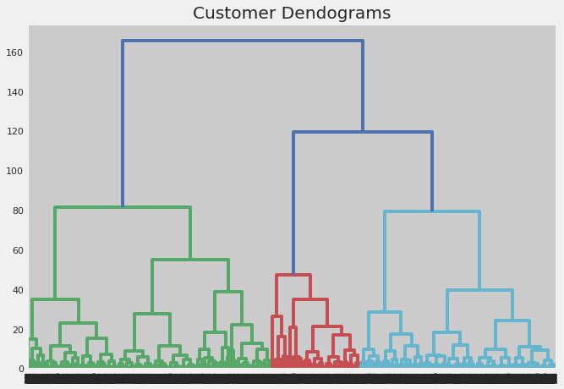
Dendogram
Notes:
Ennio

Slide 12
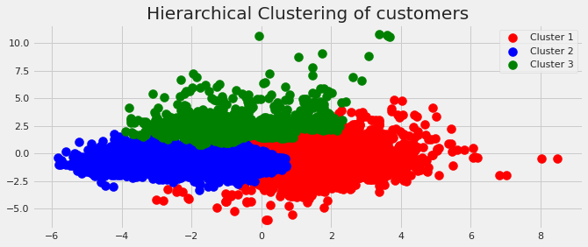
Dendogram clustering

Slide 13
Evaluation of clustering methods
K-means:
Davies-Bouldin: 0.94
Hierarchical clustering:
Davies-Bouldin: 0.92
Notes:
Ennio

Slide 14
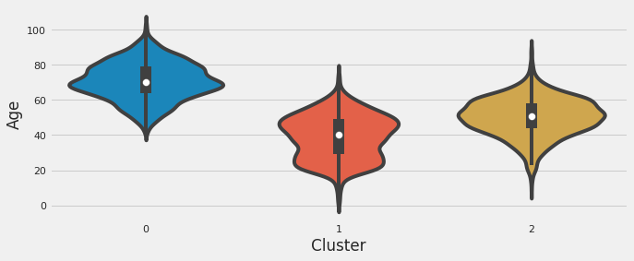
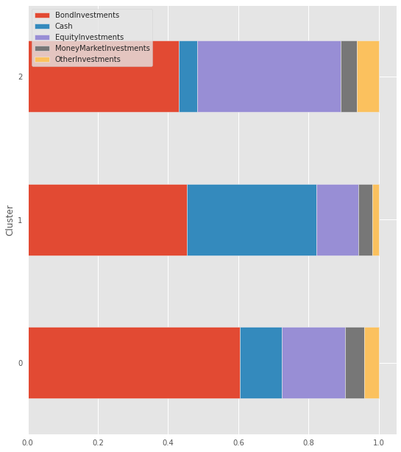
Financial Products and customer profiles
The eldery invests more in Bonds, a little in Equities and they keep some money in their bank account. People in their 40s and 60s prefer bonds and to keep a substantial part of their wealth in cash, as well as a little part of it in equities. ‘Younger’ people (20’s - 45’s) have mainly invested in bonds and equities.

Slide 15
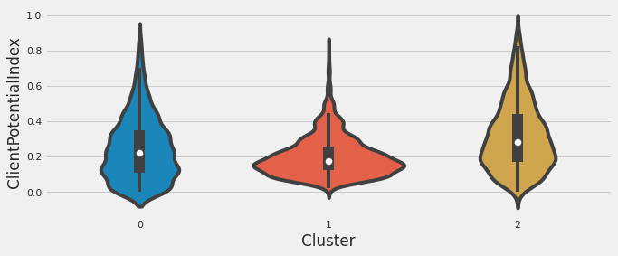
Financial Products and customer profiles
When it comes to the potential of growth of the client, the group with the highest potential (cluster2) - corresponding to people in their 40s and 60s- invested mainly in bonds and in equities, while the group with the lowest (cluster 1) - corresponding to the ‘young’ group- invested in bonds or they kept their money in their bank account.

Slide 16
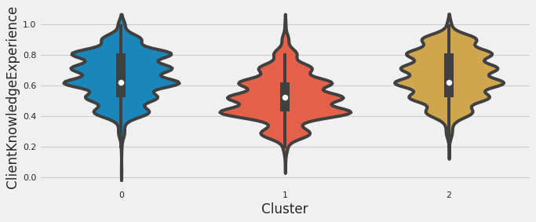
Financial Products and customer profiles
When it comes to the index of the client's level of financial culture, the ‘young’ group (cluster 1) has on average the lowest score. They invested mainly in a ‘simple’ financial product such as bonds or they kept their money in their bank account.

Slide 17
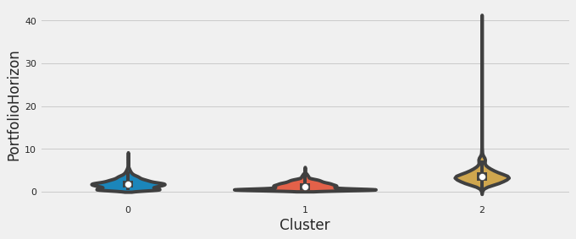
Financial Products and customer profiles
Considering the implied or ideal investment horizon in the client's portfolio and customers’ age, we can see that people between their 40’s and 60’s have a wider IQR and relevant outliers.

Slide 18
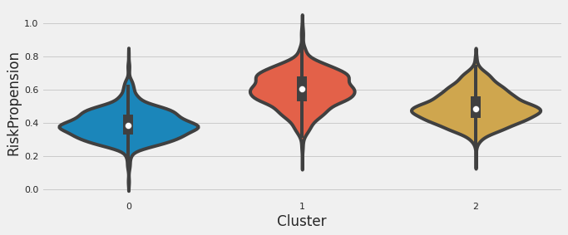
Financial Products and customer profiles
Younger people (cluster 1) have the highest score in the variable RiskPropension, which is both the propensity and the ability to bear financial risks. The ‘old’ group (cluster 0), on the contrary, has the lowest score.

Slide 19


